Slide 1
Network Analytics
Developing An Intrusion Detection
Alarm System
Team Members
Renato Barroco & Joaquin Gianantonio
Notes:
Welcome to the presentation of our network analytics project
The team members are Renato Barroco and Joaquin Gianantonio
In today’s presentation we are going to …

Slide 2
Presentation Outline
Definition of the Problem
Our Proposed MLE Solution
Information about the Data & ML Model
MLE Stack
Demo
Future Work
Notes:
... to cover the following:
We will define the problem we are addressing,
The ML solution we are proposing,
We will briefly review the data we used and the ML model we selected,
We will give a run down of the MLE stack we used and then we will jump into the demo for of our deployed solution
After that we will comment on our conclusions and proposed future work (what we would have implemented if we had more time and resources available, and what are the alternatives that we discovered as we were deploying our solution)

Slide 3
Definition of the Problem
Network infrastructures are at risk from cyber-attacks and intrusions.
This is an ever-increasing concern as we continue to expand the applications of modern-day networking: i.e., Internet of Things, smart homes, etc.
Cyber-attacks and intrusions can compromise their availability, confidentiality, and integrity.
But these threats are difficult to detect unaided because they display network traffic patterns almost indistinguishable from normal traffic.
[estimation of of losses due to network attacks: xxxx, Source xxx]
Notes:
We all know that network infrastructures are at risk of cyber attacks and intrusions
And today it is an ever-increasing concern as the applications of modern-day networking continue to expand, as with IoT and smart homes.
Cyber attacks and intrusions can compromise the availability, confidentiality and integrity of networks.
These threats are difficult to detect unaided because they display network traffic patterns tat are almost undistinguishable from the normal traffic.

Slide 4
Our Proposed Solution
We propose developing a ML-based network intrusion detection alarm system that can provide rapid identification of intrusions.
This alarm system will:
alert network administrators to take corrective action and minimize the impact.
let network engineers develop responses based on information from the app.
The alarm will help reduce interruption of service and avoid, or reduce, interrupting critical tasks and limit the cost for the user and provider.
The intrusion detection alarm will monitor network flow at port level, robustly identify threats with high accuracy and provide multi-class classification results.
Notes:
Our proposed solution is to develop a ML network intrusion detection alarm system ...
... To provide a rapid identification of potential intrusions.
This alarm system will:
Let network administrators take corrective actions and minimize the impact of the intrusion
Help network engineers to develop responses based on the information from the app
The goal of the alarm system is to help reduce the interruption of service, the interruption of critical tasks and to limit the cost of the intrusion for the user and the provider.
Our proposed intrusion detection alarm will monitor the network flow at the port level, will robustly identify any threats (with high accuracy), and will provide a multi-class result

Slide 5
Information about the Data
Our training dataset (University of Nevada – Reno, Intrusion Detection Dataset, UNR-IDD) is based on a custom application that collects and logs the available statistics captured periodically (every 5 sec – tumbling windows) from OpenFlow switches. Delta port statistics were also computed.
The main difference between UNR-IDD and other existing datasets is that UNR-IDD consists primarily of network port statistics.
UNR-IDD also address the limitation of the presence of tail classes, that there are enough samples for ML classifiers, and ensures that there are no missing network metrics.
We expect that the use of a multi-class classification for network analysis will provide a robust identification of network flow, giving (a security team) a better understanding of the type of port flow.
The intrusion detection alarm system should be deployed to be hit from an API or some sort of streaming process/batch load as events are generated. (Dashboard)
Notes:
For training our alarm system we used a dataset from the University of Nevada – Reno.
Their Intrusion Detection Dataset is based on a custom application that periodically collected and logged port statistics from open flow switches. The dataset also includes delta port statistics.
The main difference from other Network Intrusion Detection datasets is that this one consists primarily of network port statistics.
The dataset also addressed the limitation of the presence of tail classes, that there are enough samples for ML classifiers and has no missing network statistics.
We expect that providing a multi-class classification result for the network analysis will provide a robust identification of the network flow, giving a security team a better understanding of the type of network flow.
We expect that our intrusion detection alarm system will be deployed to be hit from an API or some streaming process / batch load as the events are generated

Slide 6
Information about the data (Multi-class classification)
Notes:
The dataset consist of 37.411 samples of network port statistic
The labels for the type of network activity/intrusion classes include the following:
Normal Network Functionality,
TCP SYN Flood,
Port Scanning
Flow table overflow
Blackhole attack, and
Traffic Diversion Attack.

Slide 7
Information about the ML Model
We initially tested linear regression models.
We used a Tree-based Pipeline Optimization Tool (TPOT), a python automated ML tool, for model selection and parameter optimization.
We selected and used an XGBoostClassifier for the multi-class classification project.
According to the NID literature, random forest models are the more widely used.
XGBC is s a decision tree ensembled learning algorithm similar to a random forest.
Notes:
We started by testing linear regression models.
We later used an automated tool for model selection and parameter optimization, the tree based pipeline optimization tool, or TPOT, on our reduced feature dataset.
Based on the TPOT results we selected and used an XG Boost Classifier, as it provided the more robust results for our multi-class analysis
The XG Boost Classifier is a decision tree, ensembled learning algorithm, similar to a random forest model, which, according to the Network Intrusion Detection literature is the most widely used in the field.

Slide 8










MLE Stack / EDA - Data Engineering - ML
Throughout the project we utilized the power of Github for version control and collaboration among team members.
EDA
Experimentation
Data Engineering
Feature selection
Pipeline
Data preprocessing
Model selection – lgr
Metrics
Took advantage of TPOT capabilities to select and fine tune an ML model.
Extreme Gradient Boost
parallel tree boosting
ML classification lib
Notes:
Here you can see a description of the ML stack that we used throughout the project,
The tools for Exploratory Data Analysis, data engineering and feature selection, on jupyter notebooks
Scikit learn tools for data preprocessing, model selection, metrics and pipelines
We used the TPOT tool to select and fine tune ML models
And we selected the extreme gradient boost library of ML models for our project

Slide 9




MLE Stack / Deployment
Containerization for back-end deployment
Lightweight WSGI web application framework
Enables the creation of scalable and quick back-end RESTful APIs
Front-end library that creates interactive user interfaces
Notes:
Talk about bacl end and front end
For the demo deployment of our intrusion alarm system we used
Flask to provide
We use node as it provides
We used react
We containerized the application using Docker

Slide 10
Demo / Introduction
Include here a ’capture’ of what we will show in the demo, with a very brief description of the output and The demo we have deployed, replicates the end user’s experience with our application.
The client receives an alert that a network attack is on-going:
Email to network engineers / network administrators,
Alert on a dashboard and, potentially
Some automated measures to reduce impact of attack.
The client not only receives the alert, but also a description of the type of attack.
Include Capture of our Working Demo here

Slide 11
Future Work
Real time streaming using KAFKA, Autoloader & Databricks delta lake for real-time threat detection,
Dashboarding using Plotly, Databricks environment.
Data drift analysis with a robust DevOps, CICD deployment.
Compare further the running cost of one-step classification vs two-step classification.

Slide 12
Thank You! We are now looking forward to your Questions [Github repo: https://github.com/JoaquinGianan/network-analytics] [Demo: link to demo]

Slide 13
Appendices Team Members
Renato Barroco & Joaquin Gianantonio

Slide 14
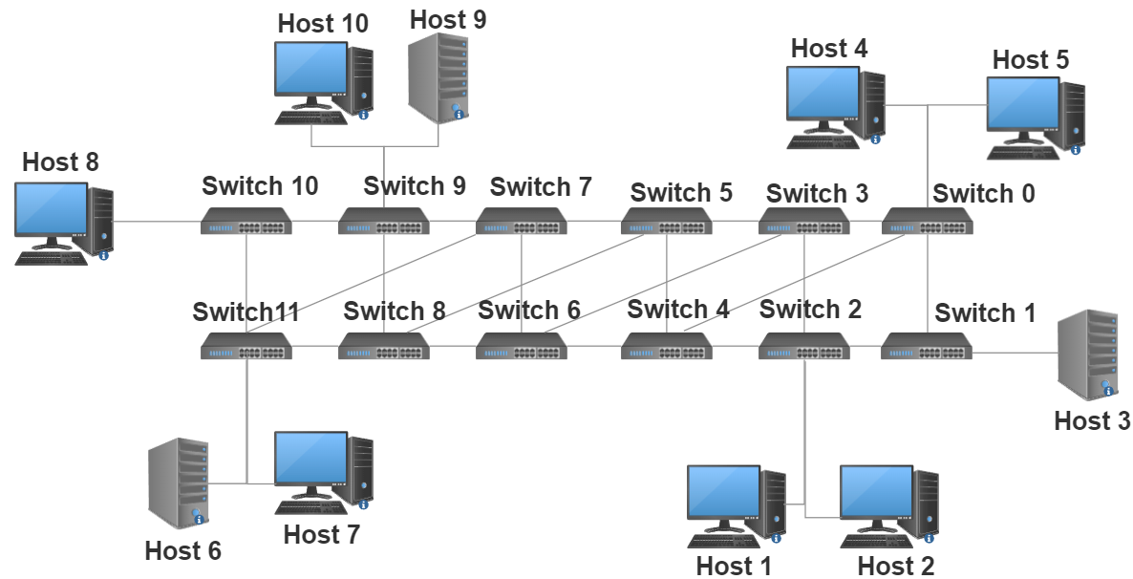
Information about the data (network topology)
Flow Simulation: IPerf is used to create TCP and UDP data streams simulating network flows in virtual and real networks using dummy payloads.
Data Collection: we create a custom application to collect and log the available statistics that are captured periodically (once in every 5 seconds) from OpenFlow (OF) switches. The statistics are collected through by means of OFPPortStatsRequest and OFPPortStatsReply messages between controller and switches.
Source: Tapadhir Das - UNR-IDD Dataset

Slide 15
Information about the Data
For this Capstone project we are using data from the University of Nevada, the Reno Intrusion Detection Dataset (UNR-IDD).
The main difference between UNR-IDD and other existing datasets is that UNR-IDD consists primarily of network port statistics.
These refer to the observed port metrics recorded in switch/router ports within a networking environment.
The dataset also includes delta port statistics which indicates the change in magnitude of observed port statistics within a time interval.
Compared to datasets that primarily use flow level statistics, these port statistics can provide a fine-grained analysis of network flows from the port level as decisions are made at the port level versus the flow level. This can lead to rapid identification of potential intrusions.
UNR-IDD also address the limitation of the presence of tail classes.
The dataset ensures that there are enough samples for ML classifiers to achieve high F-Measure scores.
Our training dataset also ensures that there are no missing network metrics and that all data samples are filled.

Slide 16
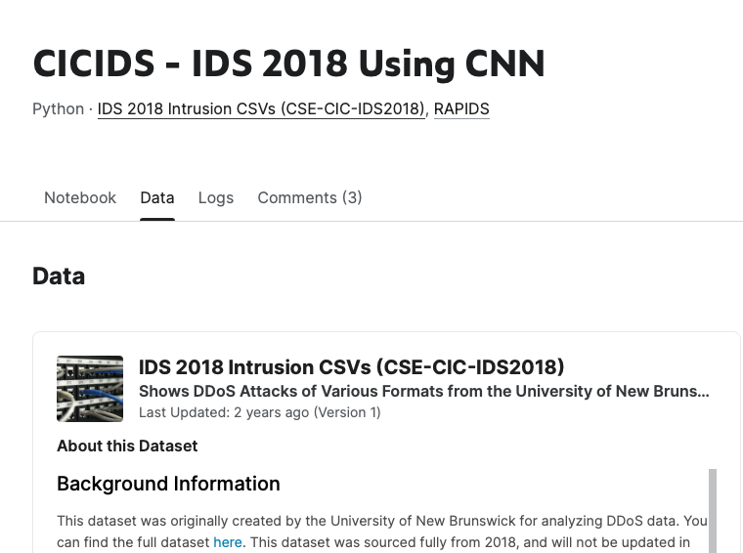

Other Datasets

Slide 17
Other Datasets
As mentioned above, the three prominent NIDS datasets are NSL-KDD [5], CIC-IDS-2018 [6], and UNSW-NB15 [3].
These datasets also have several limitations. For instance, the UNSW-NB15 suffers from inconsistent performance for machine learning classifiers. It requires more rigorous and expanded machine learning mechanisms which increases training and inference times. The NSL-KDD and CIC-IDS-2018 datasets suffer from missing data samples within their datasets.
Many of these datasets also suffer from the issue of containing inadequately modeled tail classes which leads to inconsistent performance.
For more effective intrusion detection, we need to ensure that a dataset contains a wide variety of intrusion categories.
We also need to make sure that it is complete as missing data can negatively impact the performance of prediction models.
The primary usage of port level statistics, in conjunction with some flow statistics, for NIDS is another attractive research direction that can be employed to check their efficacy at detecting network intrusions. Lastly, it is critical to ensure that tail classes have adequate representation so that prediction models can accurately capture their unique behavior and attain high performance.

Slide 18
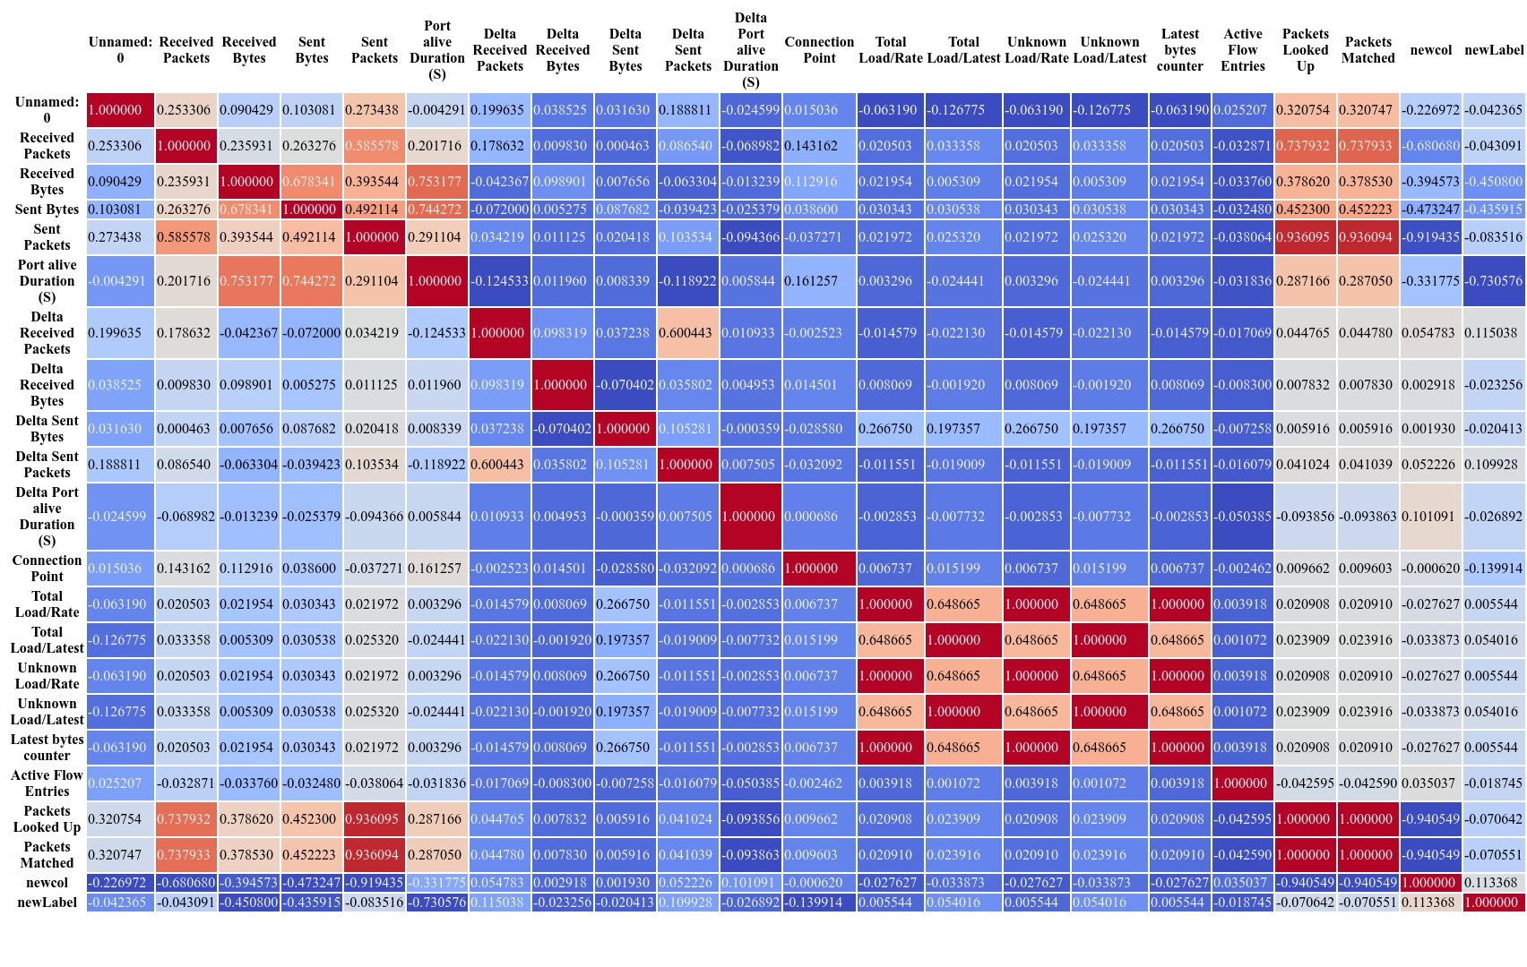
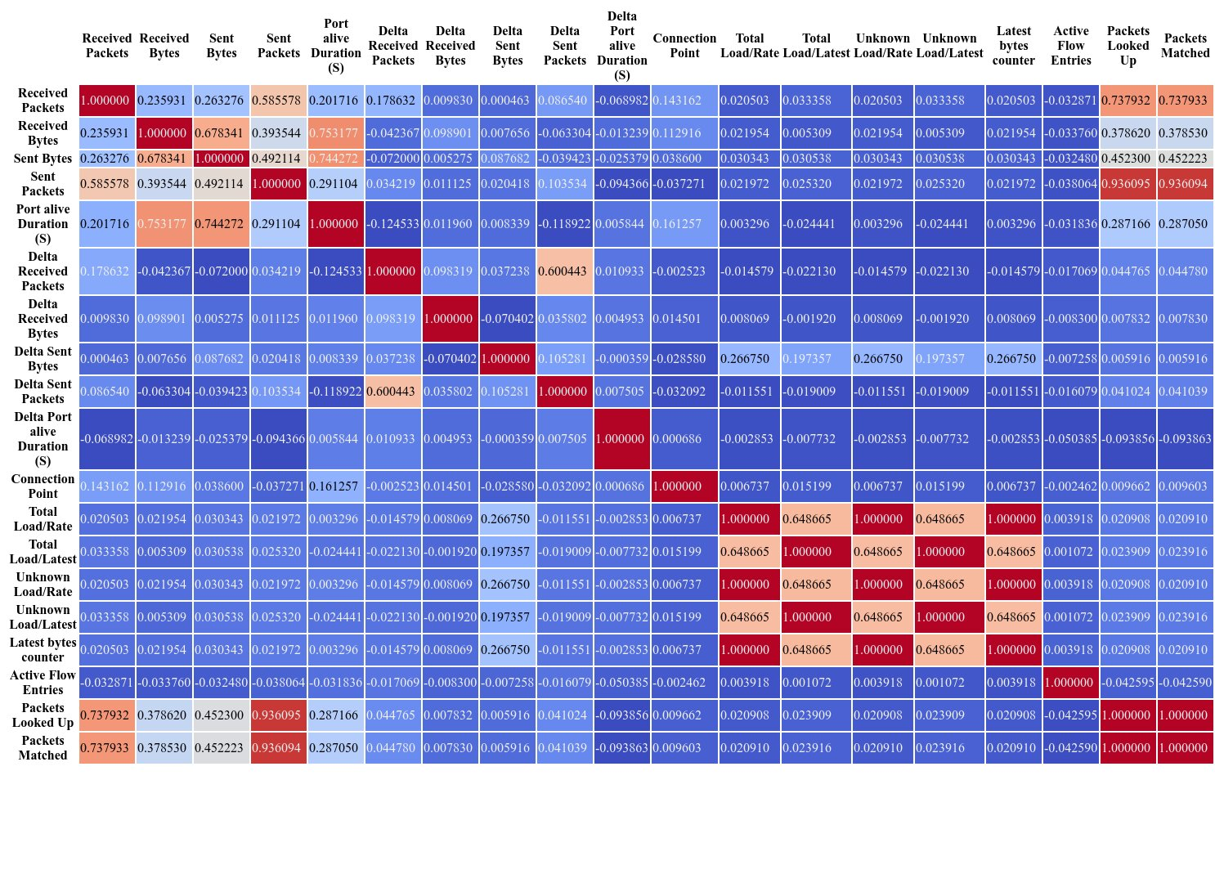
EDA
Correlation analysis performed on dataset

Slide 19
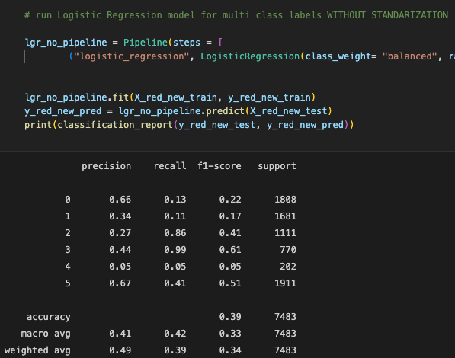
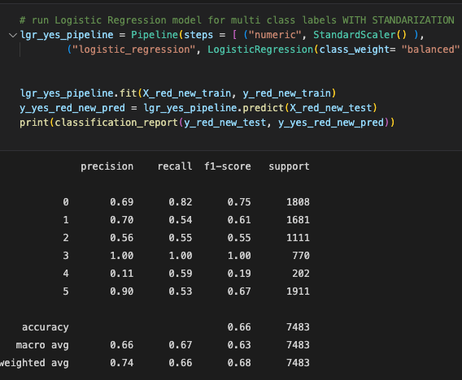
Appendices / LGR model runs

Slide 20
Model description XGBClassifier
A Gradient Boosting Decision Tree is a decision tree ensemble learning algorithm similar to random forest. Ensemble learning algorithms combine multiple machine learning algorithms to obtain a better model.
The term “gradient boosting” comes from the idea of “boosting” or improving a single weak model by combining it with a number of other weak models in order to generate a collectively strong model. Gradient boosting is an extension of boosting where the process of additively generating weak models is formalized as a gradient descent algorithm over an objective function. Gradient boosting sets targeted outcomes for the next model in an effort to minimize errors. Targeted outcomes for each case are based on the gradient of the error (hence the name gradient boosting) with respect to the prediction.
GBDTs iteratively train an ensemble of shallow decision trees, with each iteration using the error residuals of the previous model to fit the next model. The final prediction is a weighted sum of all of the tree predictions. Random forest “bagging” minimizes the variance and overfitting, while GBDT “boosting” minimizes the bias and underfitting.
XGBoost is a scalable and highly accurate implementation of gradient boosting that pushes the limits of computing power for boosted tree algorithms, being built largely for energizing machine learning model performance and computational speed. With XGBoost, trees are built in parallel, instead of sequentially like GBDT. It follows a level-wise strategy, scanning across gradient values and using these partial sums to evaluate the quality of splits at every possible split in the training set.

Slide 21
Information about the Model – TPOT run used
import numpy as np
import pandas as pd
from sklearn.model_selection import train_test_split
from xgboost import XGBClassifier
# NOTE: Make sure that the outcome column is labeled 'target' in the data file
tpot_data = pd.read_csv('PATH/TO/DATA/FILE', sep='COLUMN_SEPARATOR', dtype=np.float64)
features = tpot_data.drop('target', axis=1)
training_features, testing_features, training_target, testing_target = \
train_test_split(features, tpot_data['target'], random_state=42)
# Average CV score on the training set was: 0.9521518326659425
exported_pipeline = XGBClassifier(learning_rate=1.0, max_depth=5, min_child_weight=8, n_estimators=100, n_jobs=1, subsample=0.8500000000000001, verbosity=0)
# Fix random state in exported estimator
if hasattr(exported_pipeline, 'random_state'):
setattr(exported_pipeline, 'random_state', 42)
exported_pipeline.fit(training_features, training_target)
results = exported_pipeline.predict(testing_features)

Slide 22
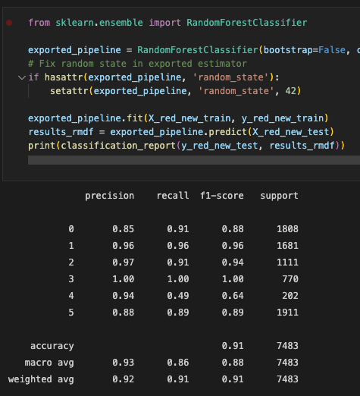
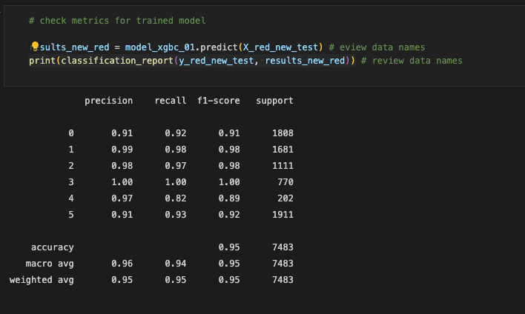
Appendices / TPOT model runs

Slide 23
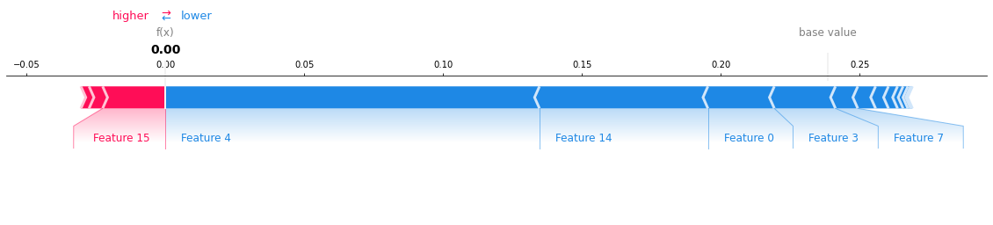
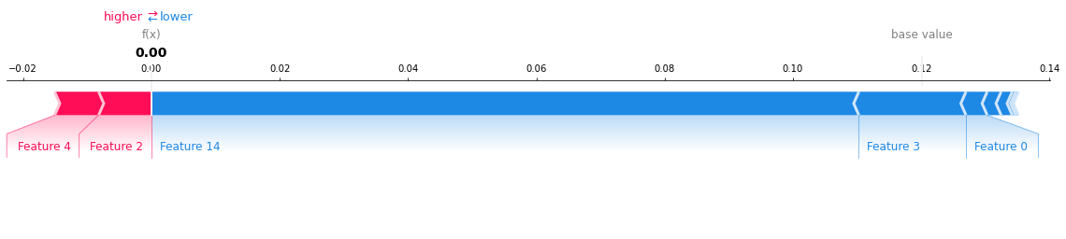
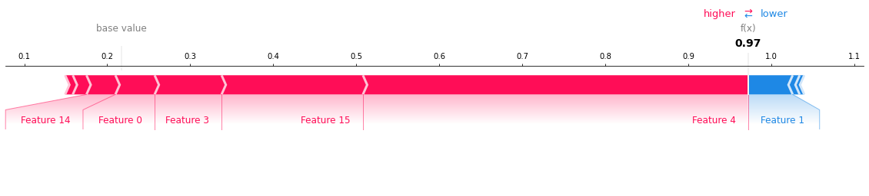
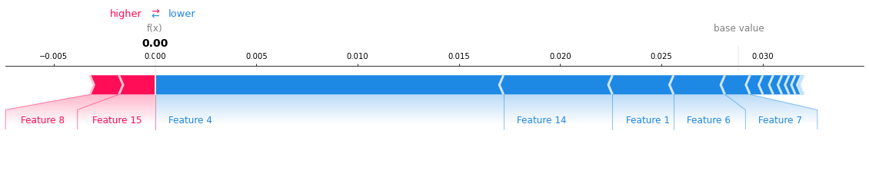
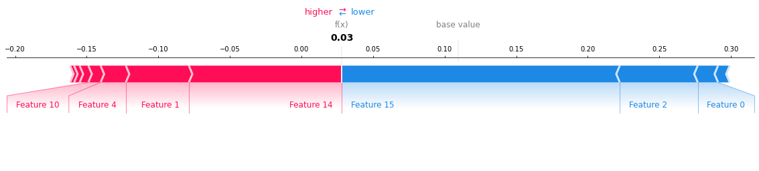
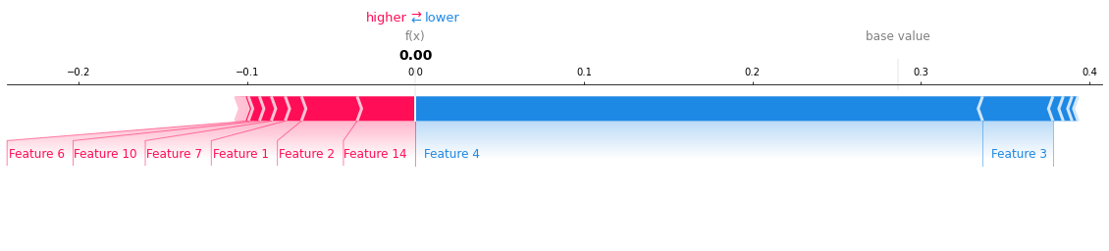
Appendices

Slide 24
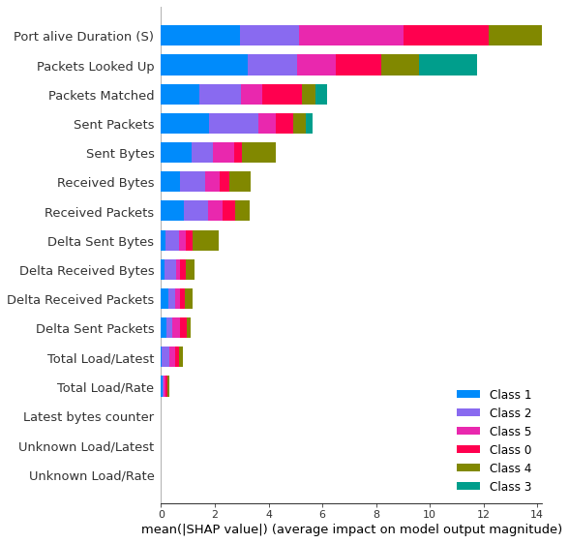
Appendices

Slide 25
Appendices

Slide 26
Appendices

Slide 27
To be continued … Team Members
Renato Barroco & Joaquin Gianantonio

Slide 28
Demo Challenges
Full workflow implementation;
Deployment in a dashboard? What tool to use?
How to simulate the use of real data to validate/test the solution?
We used unseen, test data for the Demo.
How often a model like that would need to be retrained to reflect the dataset/data drift?

Slide 29
Conclusions - WIP
We learned to do end-to-end ML the easy way, the hard way is to be able to deploy and monitor the model daily; mapping data drift and applying re-training the model using devOps solutions;
Important aspect of any MLE solution is the data engineering part of the project;
Notes:
This is where you can tell funny stories about the stupid things you did!
This is also the slide where you might convey the difference between what you set out out to do, and what you actually did.

Slide 30
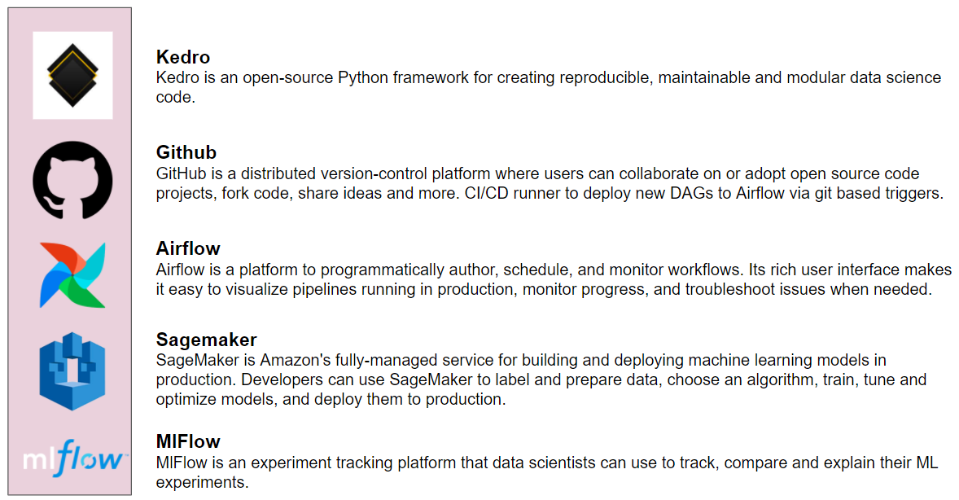
MLE Stack (2 min)
Source: https://write.agrevolution.in/ds-pipeline-the-much-needed-data-science-infrastructure-design-part-1-the-concept-4ceb57944974

Slide 31
Industry insights
Deep Learning for Network Traffic Monitoring and Analysis (NTMA)
https://www.sciencedirect.com/science/article/pii/S0140366421000426#b96
The experiments revealed that DL models provides better accuracy (with 99.20%) than the classical ML models (with 95.22%).
The authors claimed that in highly distributed networks, such as IoT systems, the traditional techniques such as classical ML techniques for NTMA purposes (e.g., attack detection) have less scalability. As a result, they proposed edge-based deep learning to deal with modern communication systems’ distributed and complex nature. The vast amount of data generated by IoT edge devices allow DL models to learn more useful than classical ML models.
https://learn.microsoft.com/en-us/azure//streaiot-hub/iot-hub-live-data-visualization-in-power-bi
https://www.databricks.com/blog/2022/05/05ming-windows-event-logs-into-the-cybersecurity-lakehouse.html
Notes:
Specify what Success looks like, and for what Audience.

Slide 32
DeepInsight pipeline
The conversion from Cartesian coordinates to pixel frames is done by averaging some features as the image size has a pixel limitation.
Drawbacks and concerns:
1) If the resolution of image or grid size is very small (compared to the number of features given), then many features overlap with each other, and image representation may not be very accurate. An appropriate resolution should be selected given the hardware capacity and the number of features required to process. Alternatively, dimensionality reduction may be applied a priori.
2) The authors acknowledge the fact that classical ML algorithms that employ experts- and manually-based methods for feature extraction are not appropriate for modern networks due to: (1) handheld devices’ massive deployment, such as smartphones and tablets, considerably increases mobile traffic volume, (2) the massive adoption of the encrypted network protocols, e.g., Transport Layer Security (TLS), reduces the effectiveness of DPI techniques based on ML algorithms, and (3) considering the ever-increasing development of mobile applications and the changing nature of mobile traffic, implementing up-to-date and accurate traffic classifiers through classical ML algorithms is challenging.
Notes:
Specify what Success looks like, and for what Audience.

Slide 33
Models
Aceto et al. [x] studied DL-based models for mobile traffic classification. They reproduced several DL classifiers, e.g., MLP, LSTM, CNN, and SAE, from the traffic classification literature in order to make a comprehensive evaluation for showing the accuracy of these classifiers.
Among DL-based classifiers, the best performance is related to 1D-CNN with 76.37%/85.70% accuracy and the F-measure of 75.56%/78.78% on FB-FBM and Android dataset, respectively.
Notes:
Specify what Success looks like, and for what Audience.

Slide 34
Models (industry)
https://www.nature.com/articles/s41598-019-47765-6
As mentioned, one of the main advantages of CNNs compared to conventional neural networks is the automatic detection of the important features and hierarchical feature extraction. A simple CNN model proposed in [93] for the categorization of encrypted traffic. This paper is one of the first works leveraging CNNs in the context of traffic classification, in which encrypted traffic is transformed into two-dimensional images, and then the images fed into the CNN model to be classified.
Notes:
Specify what Success looks like, and for what Audience.

Slide 35
Models (industry)
https://www.nature.com/articles/s41598-019-47765-6
The proposed method’s performance is evaluated with different sampling techniques (i.e., fixed step sampling, random sampling, and incremental sampling) on three different datasets, including the QUIC dataset, Unlabeled Waikato dataset, and Ariel dataset. The proposed pre-trained method achieved higher accuracy than its non-pre-trained counterpart, with 81.50%, 81.27%, and 80.76% on the QUIC dataset for the sampling techniques. As mentioned, the authors use a 1D-CNN as a classifier because they believe the using of new applications and network encryption techniques have considerably raised the complexity of the traffic classification tasks, mainly when one uses classical ML-based methods.
Notes:
Specify what Success looks like, and for what Audience.

Slide 36
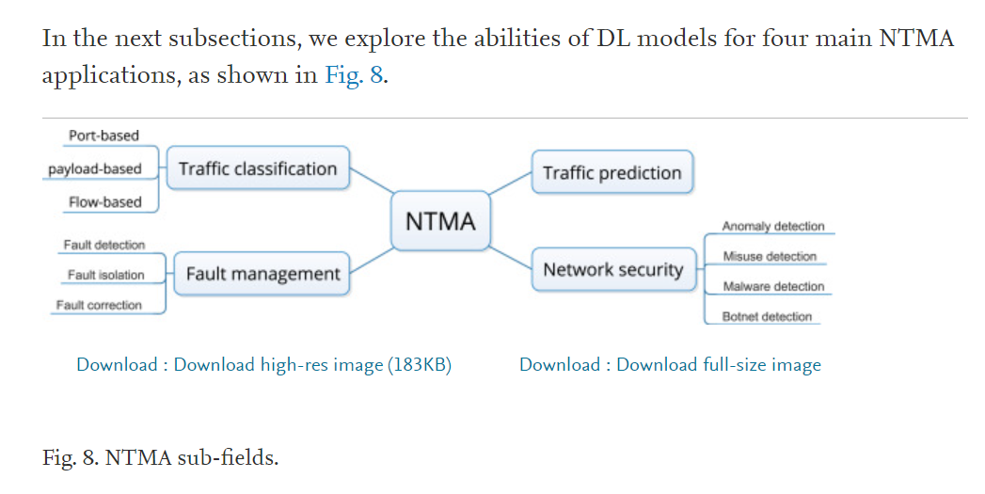
Industry insights
Notes:
Specify what Success looks like, and for what Audience.

Slide 37
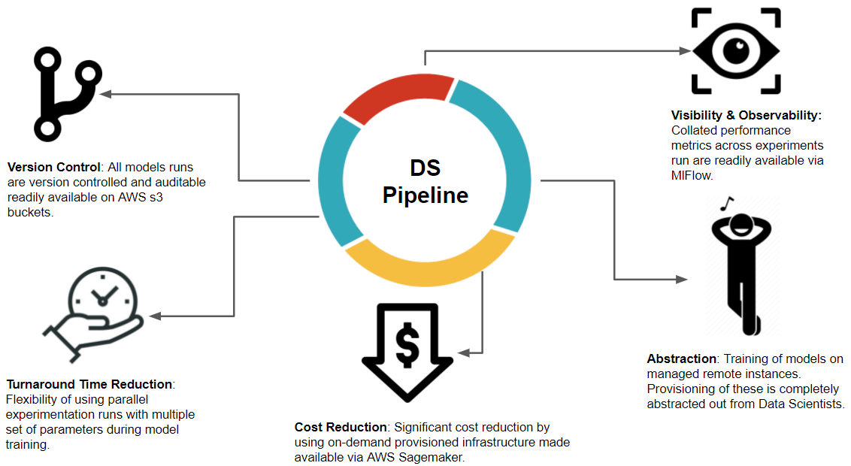
MLE Stack
Use pipelines

Slide 38
MLE Stack (initial proposal) [not in our project]use Renato’s pipeline schema
Reusable Code Structure for building ML Models
Experiment Tracking with model Artifacts
Training of Models on Managed Remote instances
Version control of Trained models
Git-based triggers to train and deploy models
Deployment of Trained models on Managed Remote instances
Monitoring and Logging of deployed models
Integration of Deployed endpoints with API Gateway

